Slide 1


Department of Artificial Intelligence & Data Science
Project Work Phase – I
Second Review
ROOT CAUSE DRIVEN CI/CD PIPELINE AUTOMATION
Batch Members:
NISHANTH A - 727723EUAI079
PRANESH J S - 727723EUAI089
RAKESH A - 727723EUAI095
SABARISH S – 727723EUAI102
Batch No: 10
Supervisor: Ms STENNI MARTIN
Date: 22/07/2026 FN

Slide 2

Problem Statement(s)
Define the Problem:
  Organizations run CI/CD pipelines that fail frequently due to flaky tests, config drift, and code regressions, and struggle to keep up with practice of manual RCA. Manual log analysis to find the root cause is slow, costly, and error-prone.
Context and Background:
  Modern microservice-based systems produce huge volumes of build/test logs across many stages and services. The traditional CI/CD tooling has not kept pace with how quickly pipelines and codebases change.
  Engineers repeatedly re-diagnose recurring or flaky failures by hand, wasting engineering hours.
Impact of the Problem:
  Undiagnosed or slowly-diagnosed failures lead to delayed releases, higher Mean Time to Repair (MTTR), and lost engineering productivity. Teams need an automated solution to continuously detect, diagnose, and fix pipeline failures.

Slide 3
Objective(s)
Primary Objective:
  Develop an LLM-driven framework that automatically detects CI/CD pipeline failures, performs root cause analysis (RCA) and verified fixes with minimal human intervention.
Secondary Objectives:
  Classify failures as flaky (transient) vs. genuine (real fault) using log signatures and historical patterns.
  Perform RCA using structured log context, code/dependency information, and historical failure data.
  Generate automated fix suggestions and verify them via a sandboxed rerun before merge.
Measurable Outcomes:
  Accuracy: Achieve at least 85% correct classification of flaky vs. real failures on test pipelines.
  Efficiency: Reduce Mean Time to Diagnosis (MTTD) from hours to under 5 minutes per failure — a 90%+ reduction.
  Coverage: Evaluate the framework across 30–50 sample CI/CD failure cases drawn from open-source pipelines.

Slide 4
Concept Development and Innovation
From Review 1 to Review 2:
  The initial concept — an LLM-driven detect-diagnose-fix loop — has been developed into a concrete layered architecture with defined modules, data stores, and verification gates.
Core Innovations:
  Triage-first design: flaky/real classification gates expensive RCA effort, unlike existing alerting-only tools.
  Structured, not raw, context: logs, dependency graphs, and historical matches are retrieved and structured before reasoning, avoiding context degradation.
  Graph-aware fault localization: dependency-graph reasoning traces faults across microservice boundaries rather than a single log file.
  Sandbox-verified auto-fix: proposed fixes are never merged on LLM confidence alone — only after a real, isolated rerun passes.
Novelty vs. Existing Tools:
  Existing tools (Jenkins Blue Ocean, Datadog CI Visibility, Nx Self-Healing CI) stop at detection or suggestion; this framework closes the loop with classification and RCA and verified remediation in one pipeline.

Slide 5
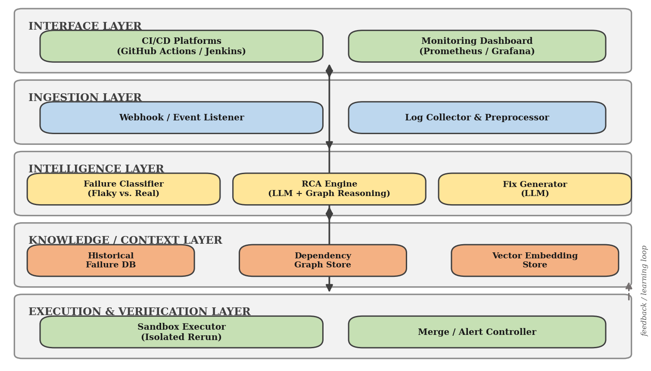
System Architecture

Slide 6
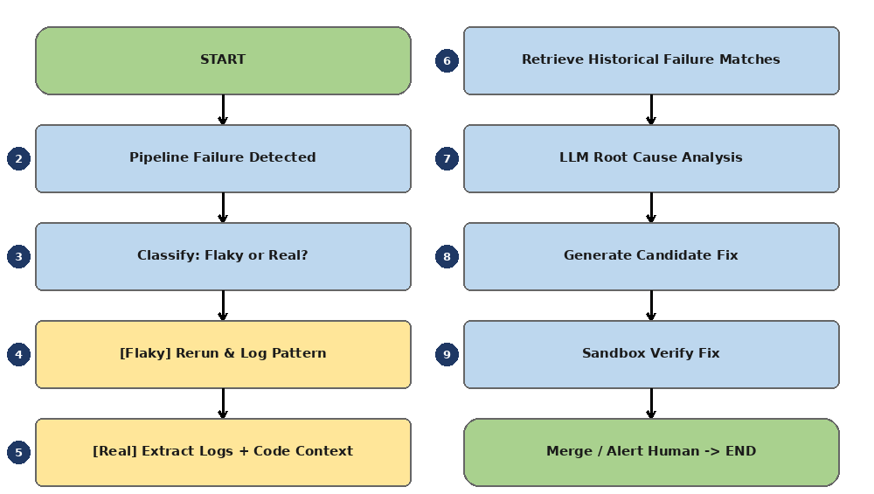
Flow Diagram

Slide 7
Methodology
Overall Approach:
  A five-phase pipeline takes a CI/CD failure from raw logs to a verified, merge-ready fix, with each phase producing structured output consumed by the next.
Phase 1 – Data Collection & Preprocessing:
  Capture build/test logs, stack traces, exit codes, and pipeline metadata via webhooks from GitHub Actions/Jenkins.
  Normalize and chunk logs, strip noise, and extract structured events (timestamps, stage, error signatures).
Phase 2 – Failure Classification:
  Compare log/error signatures against historical run patterns to label each failure as Flaky or Real before spending RCA effort.
Phase 3 – Root Cause Analysis:
  For real failures, the LLM reasons over structured log context, the code dependency graph, and similar past incidents to localize the faulty stage/component.
Phase 4 – Fix Generation & Verification:
  Generate a candidate config/code fix, apply it in an isolated sandbox, and rerun the failed stage to confirm the fix before merge.
Phase 5 – Evaluation:
  Benchmark against 30–50 labeled open-source pipeline failures for classification accuracy, MTTD, and fix success rate.

Slide 8
Design Justification
Why Triage Before RCA:
  Classifying flaky vs. real first prevents the expensive RCA/LLM pipeline from running on transient failures, cutting wasted compute and engineer attention.
Why Structured Context, Not Raw Logs:
  Feeding raw logs directly into an LLM causes context rot on large codebases; structured, retrieval-filtered context keeps reasoning focused and accurate.
Why Dependency-Graph-Aware Reasoning:
  Microservice failures often originate in a different service than where they surface — graph-aware reasoning traces the fault across service boundaries instead of one log file.
Why Sandbox Verification Before Merge:
  An LLM-proposed fix is only a hypothesis; re-running it in an isolated sandbox is the only way to confirm correctness without risking the main branch.
Why This Technology Stack:
  Python + LLM API (Claude) + standard CI/CD tooling (Jenkins/GitHub Actions) keeps the system lightweight and deployable alongside existing pipelines, with no proprietary infrastructure.

Slide 9
Design Correctness / Methodology
Grounded Reasoning:
  RCA and fix generation are grounded in retrieved evidence (actual logs, diffs, dependency data) rather than free-form generation, reducing hallucination risk.
Deterministic Verification:
  Every proposed fix is validated by an actual sandboxed rerun of the failed stage — correctness is confirmed by execution, not by LLM confidence.
Schema-Validated Outputs:
  Classifier and RCA outputs follow a fixed structured schema (label, faulty component, confidence), so downstream stages can reliably act on them.
Human-in-the-Loop Gate:
  Merge approval remains human-gated by default; the system proposes and verifies, minimizing — not eliminating — human intervention.
Testing Plan:
  Unit tests per module (classifier, RCA engine, fix generator), integration tests across the full pipeline, and system-level validation against the 30–50 case benchmark.

Slide 10
Evaluation Criteria
Classification Accuracy:
  ≥ 85% correct flaky-vs-real classification on labeled test pipelines; tracked with precision/recall to avoid over-flagging real faults as flaky.
Diagnostic Efficiency (MTTD):
  Mean Time to Diagnosis reduced from hours to under 5 minutes per failure — a 90%+ reduction versus manual log analysis.
Root Cause Localization Quality:
  Top-1 and Top-3 accuracy of the RCA engine in identifying the correct faulty stage/component, validated against ground-truth incident records.
Fix Verification Success Rate:
  Proportion of generated fixes that pass the sandboxed rerun on the first attempt, without further human correction.
Coverage:
  Framework evaluated across 30–50 real CI/CD failure cases drawn from open-source pipelines, spanning flaky tests, config drift, and code regressions.
Operational Impact:
  Reduction in engineering hours spent on manual RCA, and improvement in release velocity (fewer delayed merges).

Slide 11
Feasibility and Planning
Technical Feasibility:
  Built entirely on Python, an LLM API (Claude), and standard CI/CD tooling (Jenkins/GitHub Actions, Prometheus/Grafana) — no custom infrastructure required.
Economic Feasibility:
  Estimated cost of ₹6,000 (LLM API credits, cloud hosting, documentation), largely covered by free/open-source tools and student cloud credits.
Operational Feasibility:
  Deploys alongside existing pipelines as a webhook-triggered service — no disruption to current CI/CD workflows or team processes.
Planning for Next Phase:
  Weeks 1–3: finalize log preprocessing and failure classifier.
  Weeks 4–6: integrate RCA engine and fix generator with sandbox verification.
  Weeks 7–8: full-pipeline testing, benchmarking, and documentation for Phase-II review.

Slide 12
Time frame/ Schedule for completion
Task | Week 1 | Week 2 | Week 3 | Week 4 | Week 5 | Week 6 | Week 7 | Week 8
Requirement Analysis & Literature Review | ███ | ███
System Design & Architecture |  | ███ | ███
Log Preprocessing Module |  |  | ███ | ███ | ███
Failure Classifier (Flaky vs. Real) |  |  | ███ | ███ | ███ | ███
RCA Engine (LLM Integration) |  |  |  | ███ | ███ | ███
Fix Generator & Sandbox Verification |  |  |  |  | ███ | ███ | ███
Testing & Bug Fixes |  |  |  |  |  | ███ | ███
Documentation & Phase-1 Review |  |  |  |  |  |  | ███ | ███

Slide 13
Budget
Item | Estimated Cost (₹)
Development Tools (Jenkins, Python) | Free
Monitoring Stack (Prometheus/Grafana) | Free
LLM API Credits | 2,000
Cloud Hosting (AWS/Render) | 2,000
Domain Name (Optional) | 1,000
Documentation & Miscellaneous | 1,000
Total Estimated Cost | ₹6,000
Cost Breakdown:
Resources Needed:
  Laptop/PC
  Internet Connection
  VS Code / PyCharm
  Jenkins / GitHub Actions
  LLM API (Claude)
  Git & GitHub
  Prometheus/Grafana
Funding Sources:
  Self-funded
  College Project Support (if available)
  Free/Open-Source Tools
  Free Cloud Credits (GitHub Student Pack)

Slide 14
Expected Outcomes
Results:
  Develop an LLM-powered system that automatically detects CI/CD pipeline failures, diagnoses the root cause, and generates a verified fix with minimal manual effort.
Benefits:
  Reduces manual log-analysis time and repetitive re-diagnosis of recurring failures.
  Improves release velocity by cutting Mean Time to Diagnosis and Repair.
  Frees engineering time from routine failure triage to feature development.
Applications:
  Software engineering teams and DevOps groups
  Organizations running microservice-based CI/CD pipelines
  SRE and platform engineering teams

Slide 15
Reference(s)
Citations:
  Xu et al., “LogSage: An LLM-Based Framework for CI/CD Failure Detection and Remediation,” IEEE/ACM ASE 2025.
  Aïdasso et al., “On the Diagnosis of Flaky Job Failures,” IEEE/ACM ICSE-SEIP 2025.
  Cui et al., “PRAXIS: Integrating Program Analysis with Observability for RCA,” IEEE/IFIP DSN 2026.
  “An AI-Powered Pipeline for Enabling Self-Healing in Software Systems,” IEEE Xplore.
  MicroRCA — IEEE/IFIP NOMS 2020.
  COCA: Generative Root Cause Analysis, IEEE/ACM ICSE 2025.
Further Reading:
  Shahin, Babar, Zhu — CI/CD Systematic Review, IEEE Access 2017
  LLM Context Rot / Long-Context Degradation Studies
  SAP HANA CI/CD Failure Management Case Study, 2026
  Graph-Structured Program Dependence Analysis Research

Slide 16
Results/Outputs
Expected Results
  Automated end-to-end diagnosis of CI/CD pipeline failures.
  Accurate separation of flaky vs. real failures before RCA effort is spent.
  Reduced manual log-reading effort and faster failure resolution.
  LLM-generated, sandbox-verified fix recommendations.
System Outputs
Output | Description
Failure Classification | Flags failure as Flaky or Real.
Root Cause Report | Identifies the likely faulty stage/component.
Fix Suggestion | Proposes a concrete config/code fix.
Verification Result | Sandbox rerun pass/fail before merge.
MTTD/MTTR Metrics | Tracks diagnosis and repair time saved.
Deployment Log | Records the final merge/alert decision.

